Slide 1
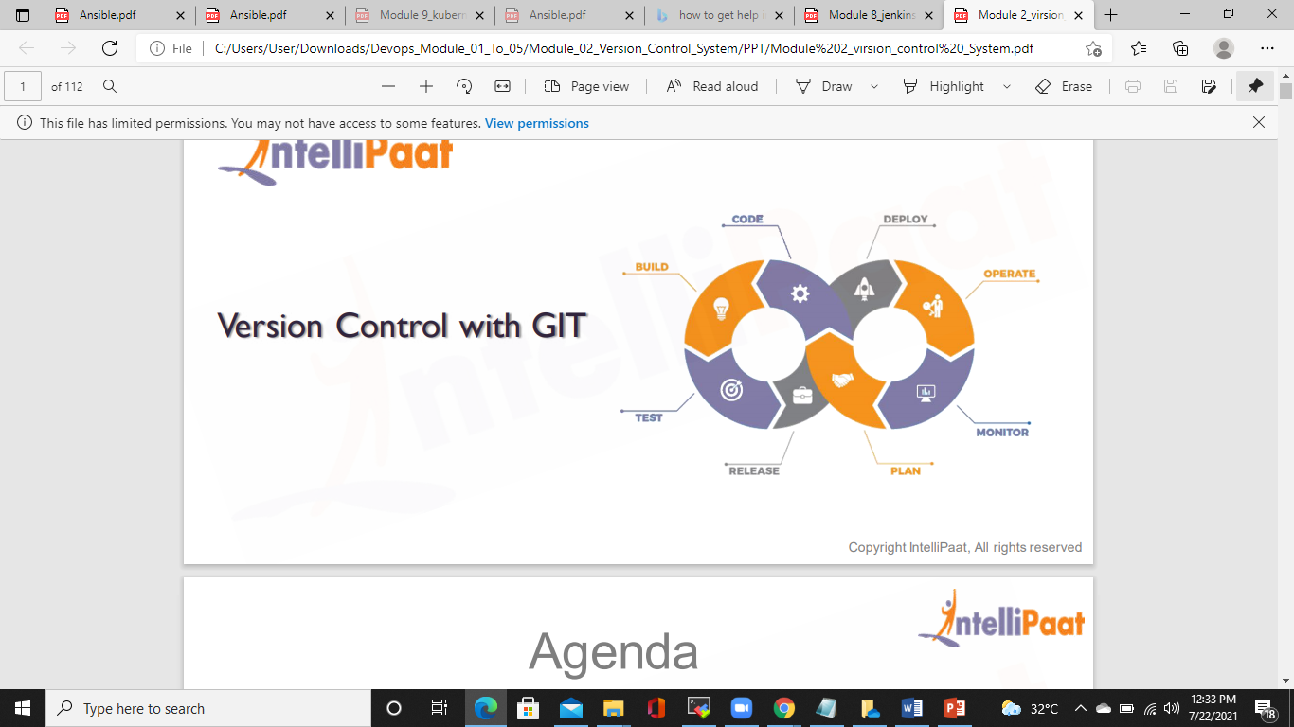

Slide 2
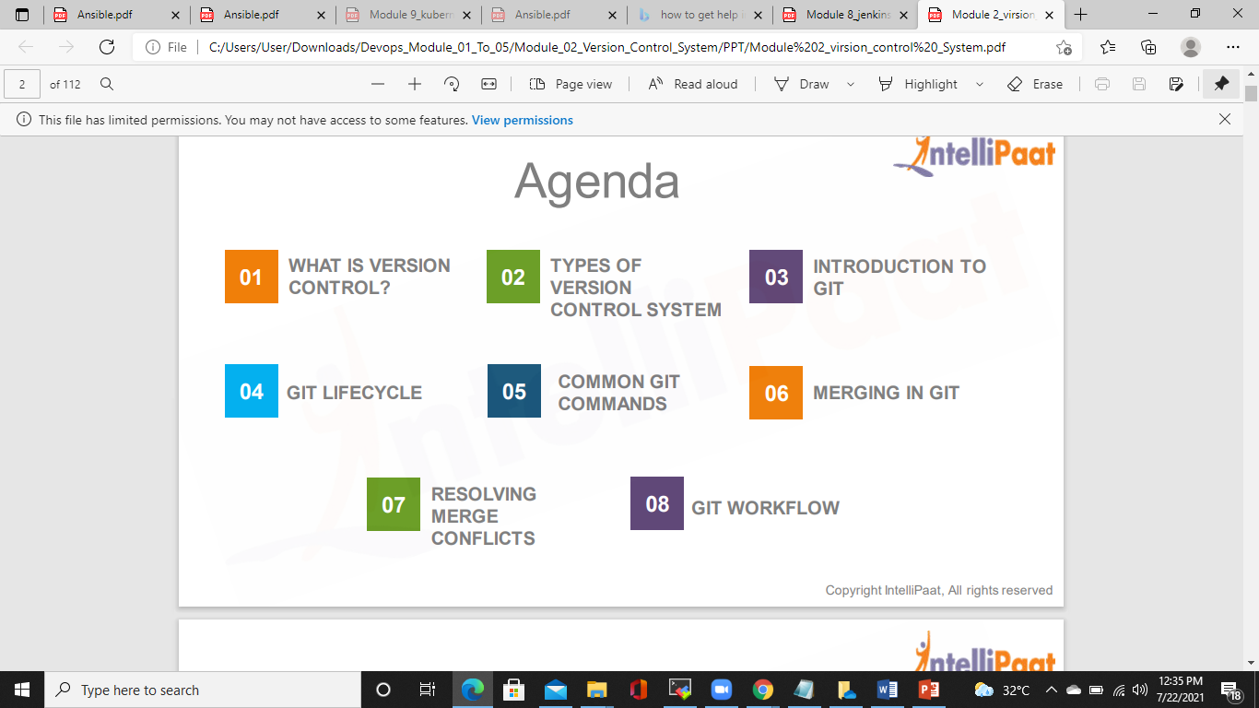
AGENDA

Slide 3
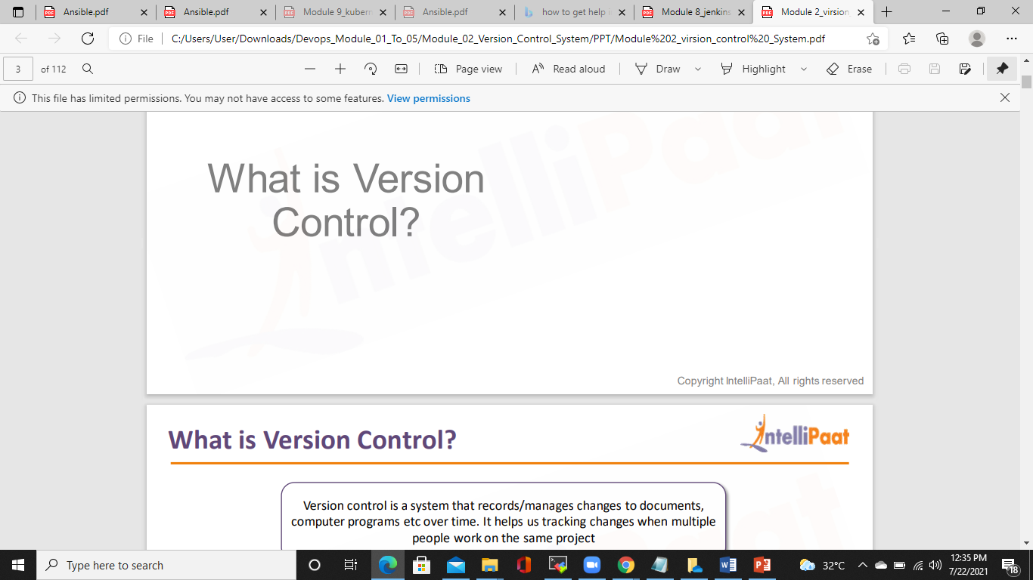
WHAT IS VERSION CONTROL?

Slide 4
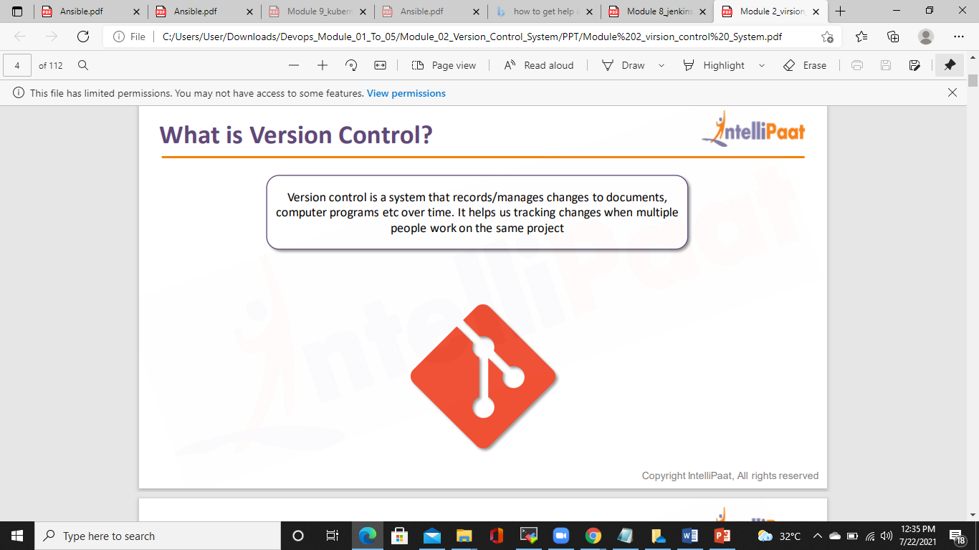

Slide 5
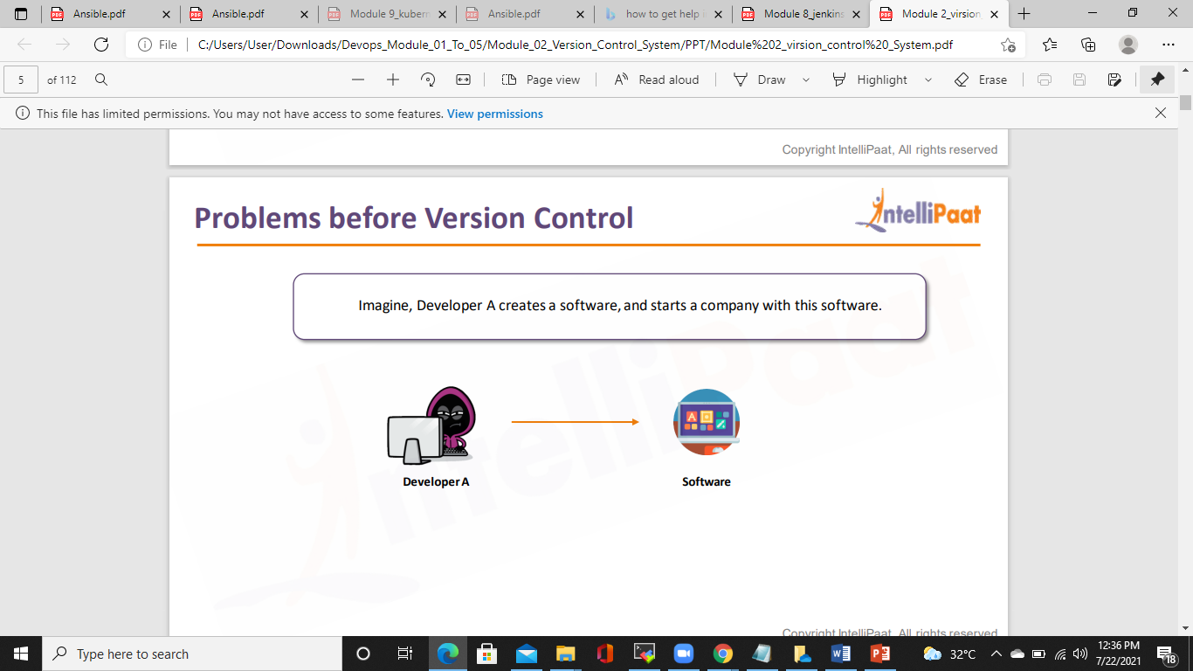
PROBLEMS BEFORE VERSION CONTROL

Slide 6
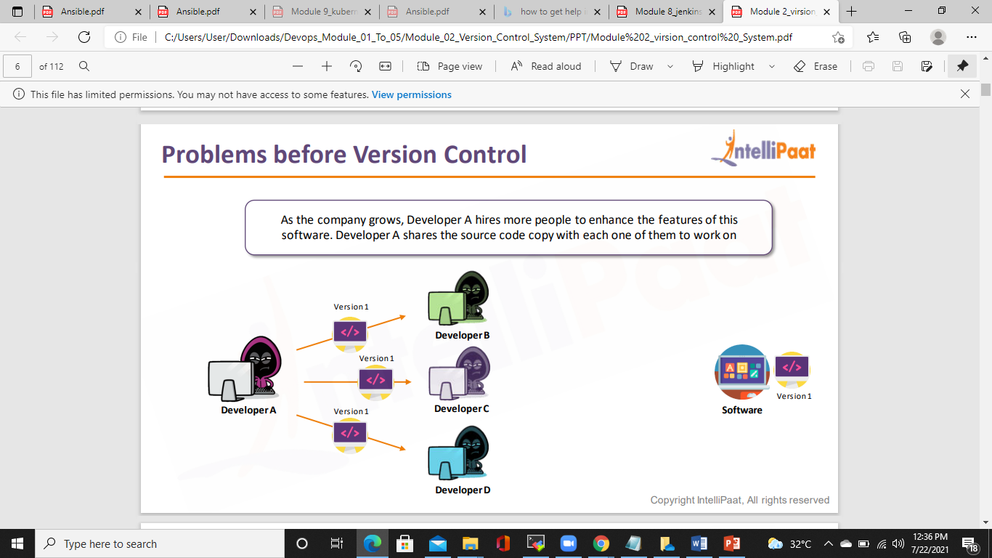
PROBLEMS BEFORE VERSION CONTROL

Slide 7
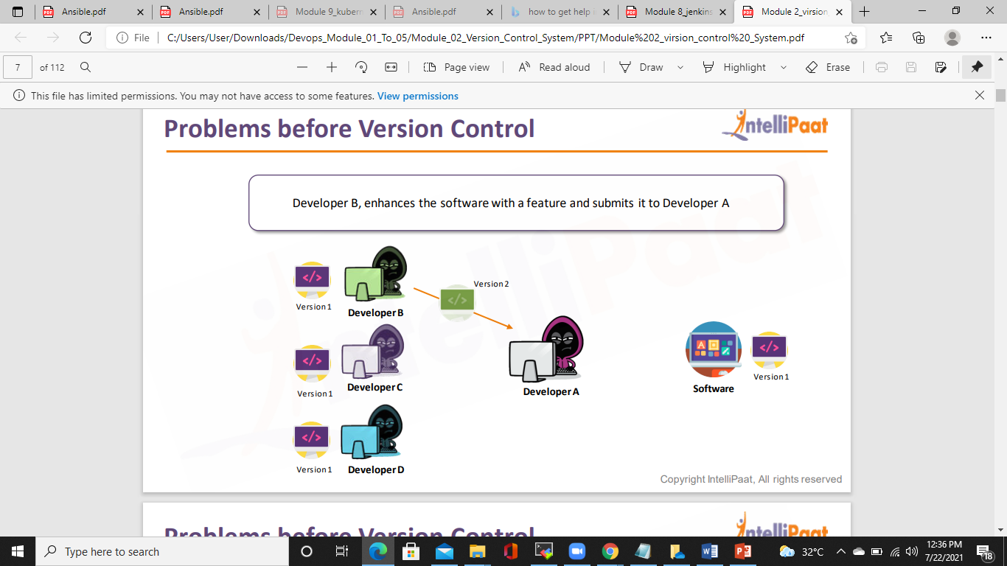
PROBLEMS VEFORE VERSION CONTROL

Slide 8
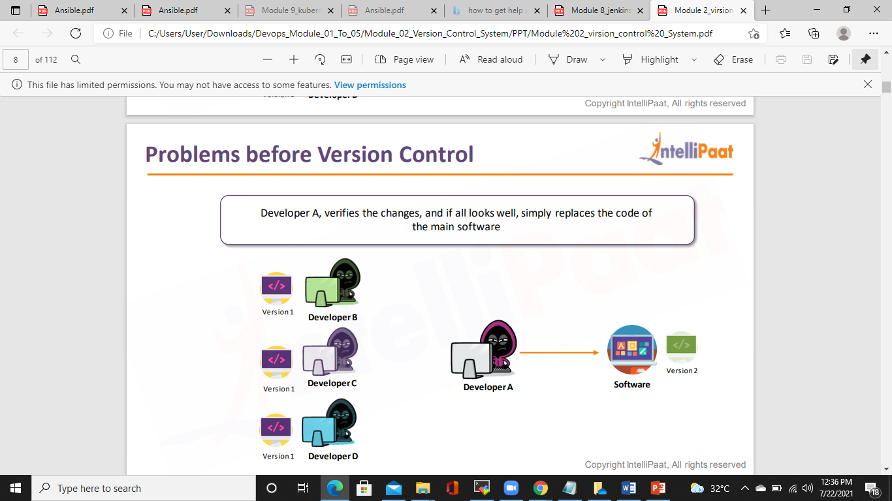
PROBLEMS BEFORE VERSION CONTROL

Slide 9
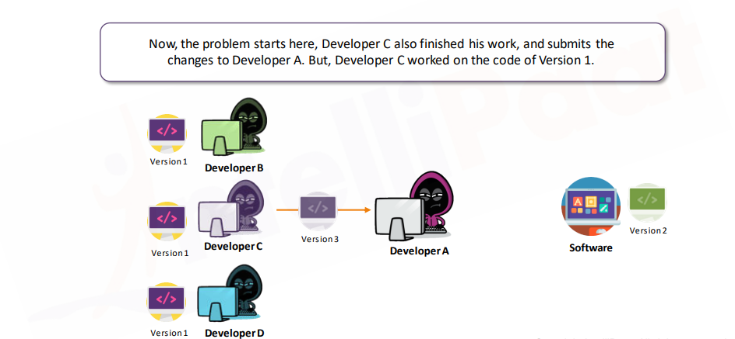
PROBLEMS BEFORE VERSION CONTROL

Slide 10
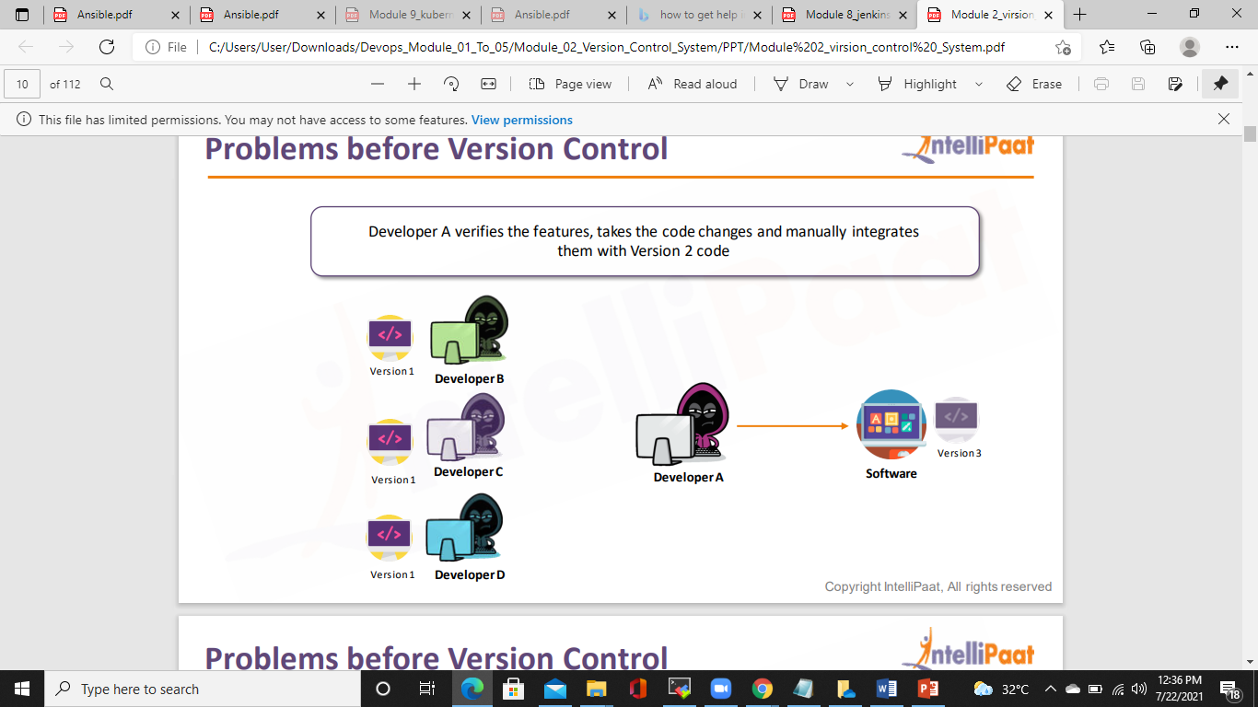
PROBLEMS BEFORE VERSION CONTROL

Slide 11
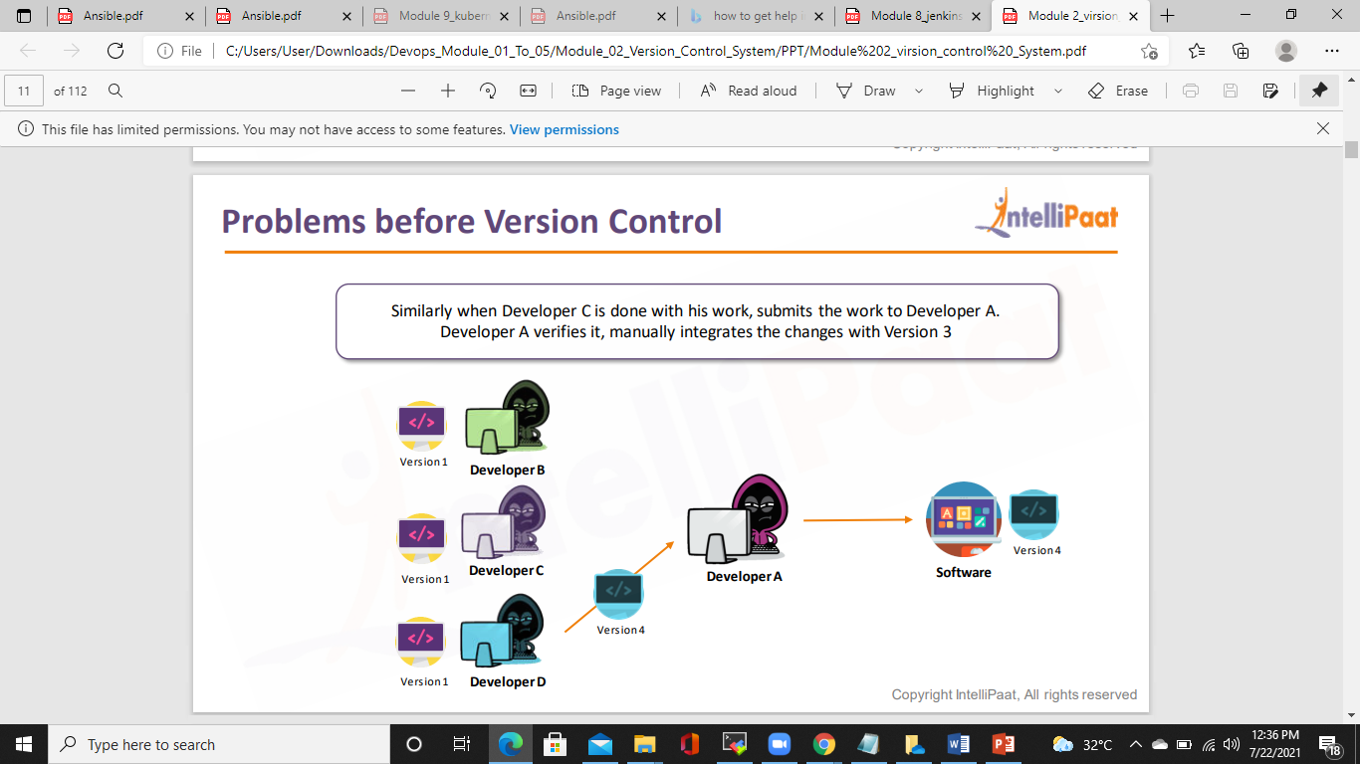
PROBLEMS BEFORE VERSION CONTROL

Slide 12
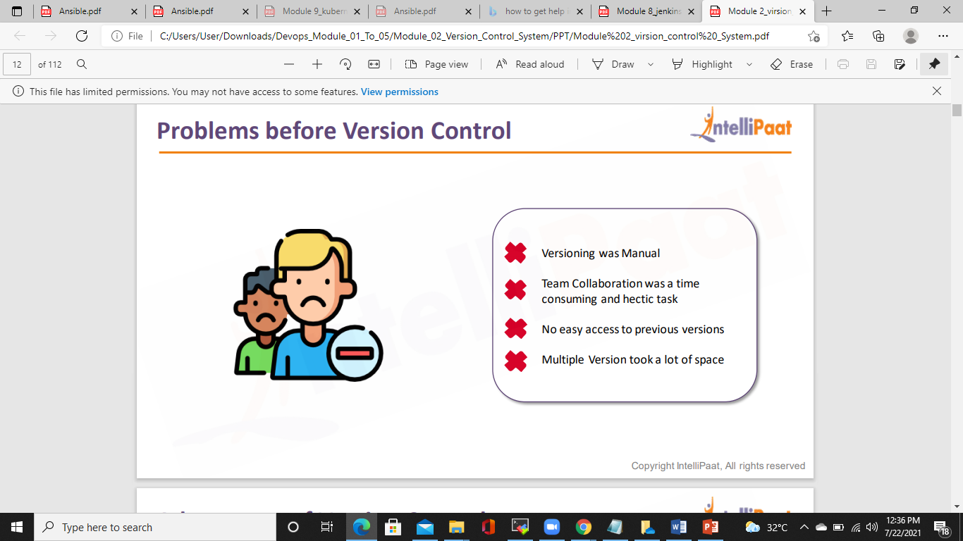
PROBLEMS BEFORE VERSION CONTROL

Slide 13
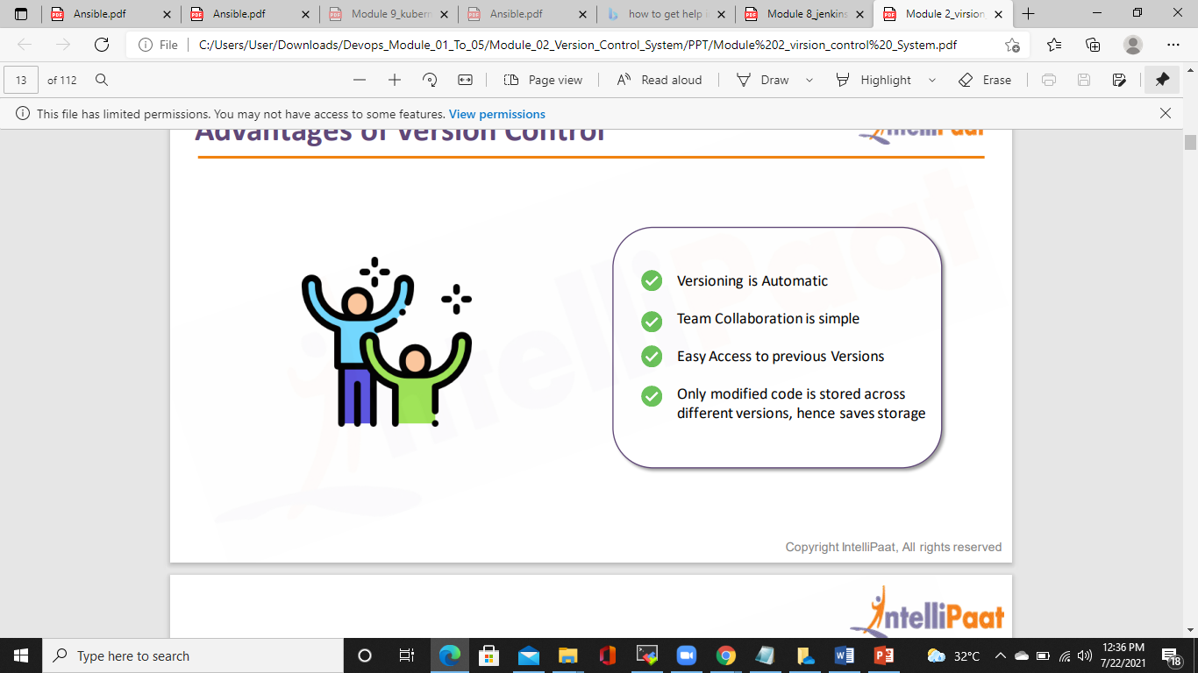
ADVANTAGES OF VERSION CONTROL

Slide 14
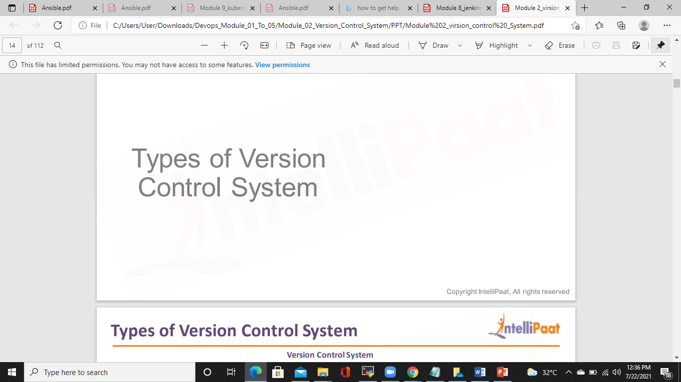

Slide 15
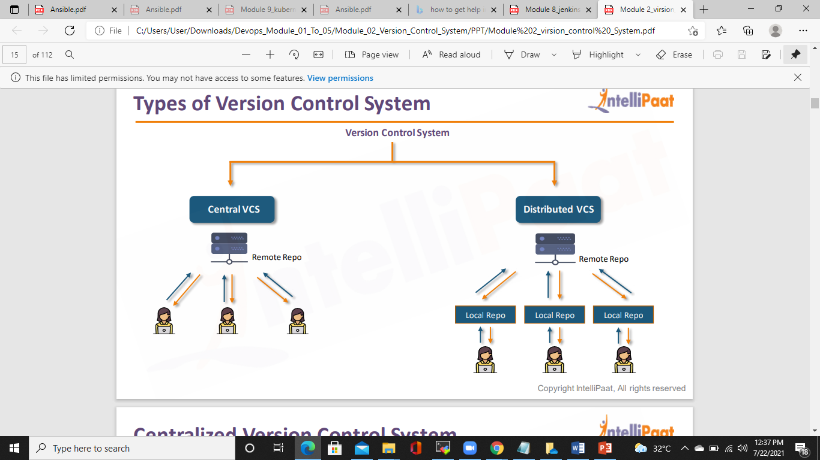
TYPES OF VERSION CONTROL

Slide 16
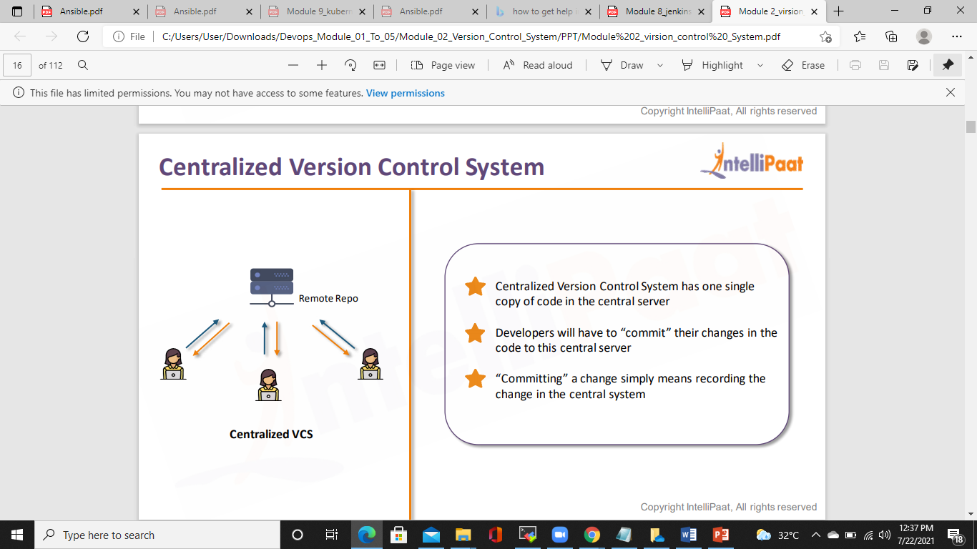
CENTRALIZED VERSION CONTROL SYSTEM

Slide 17
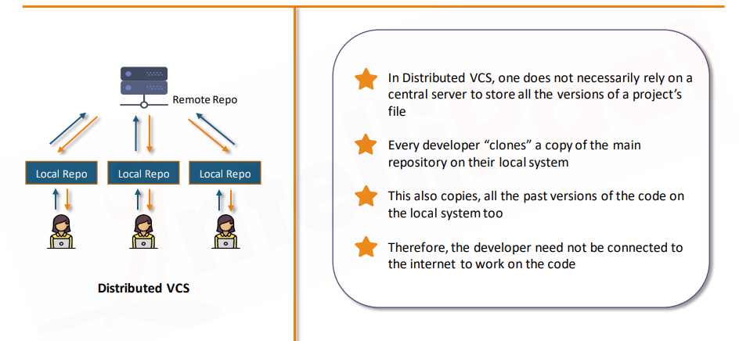
Distributed Version Control System

Slide 18
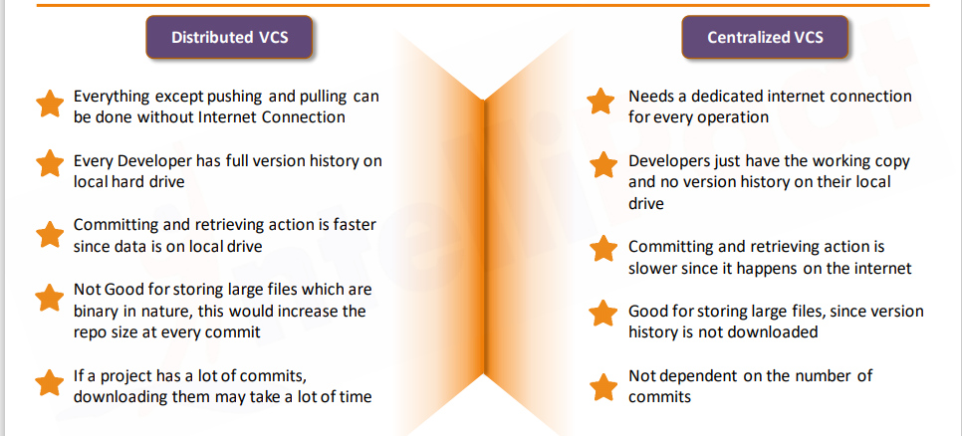
Difference between DVCS & CVCS

Slide 19
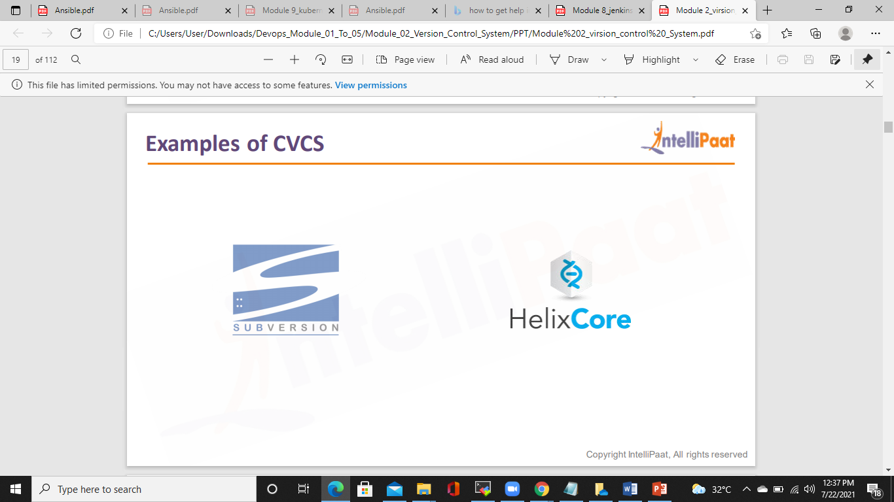
EXAMPLES OF CVCS

Slide 20
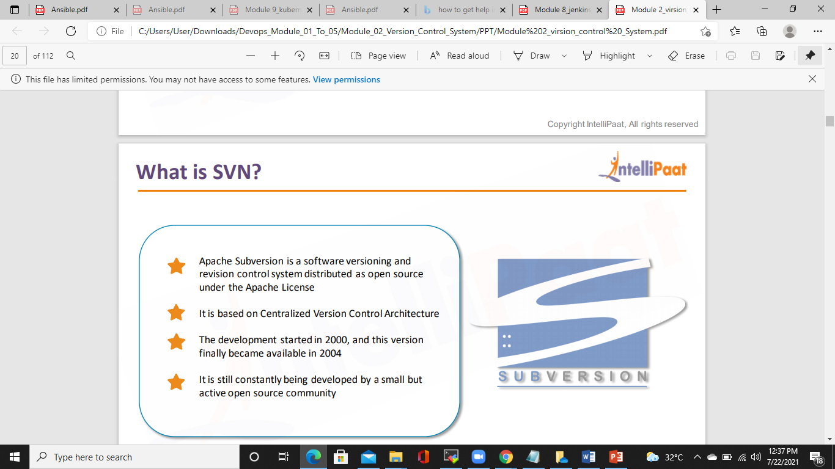
WHAT IS SVN?

Slide 21
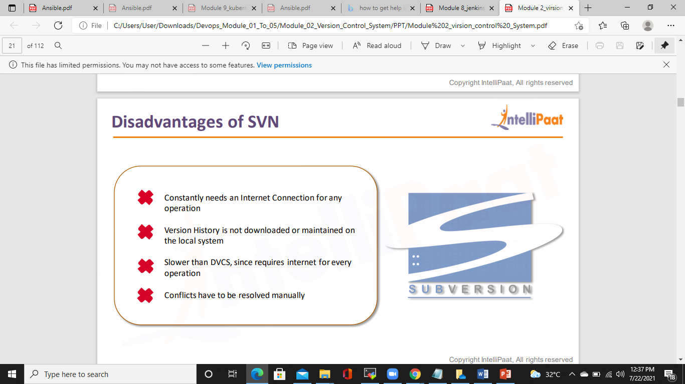
DISADVANTAGES OF SVN

Slide 22
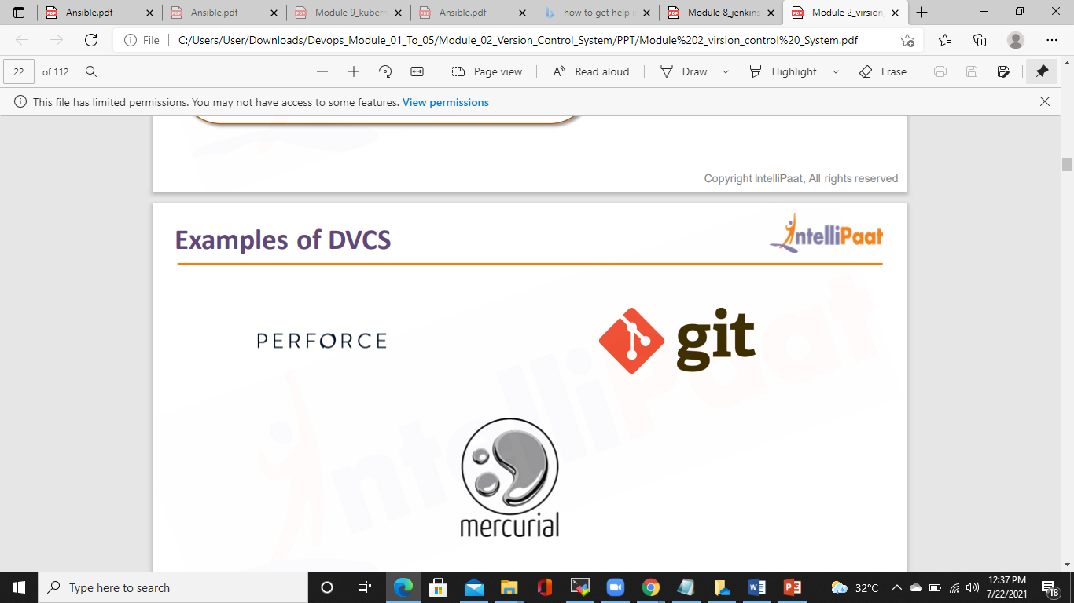
EXAMPLES OF DVCS

Slide 23
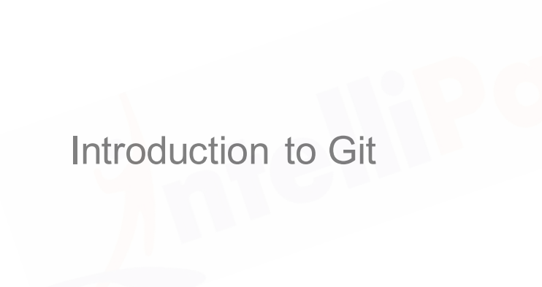

Slide 24
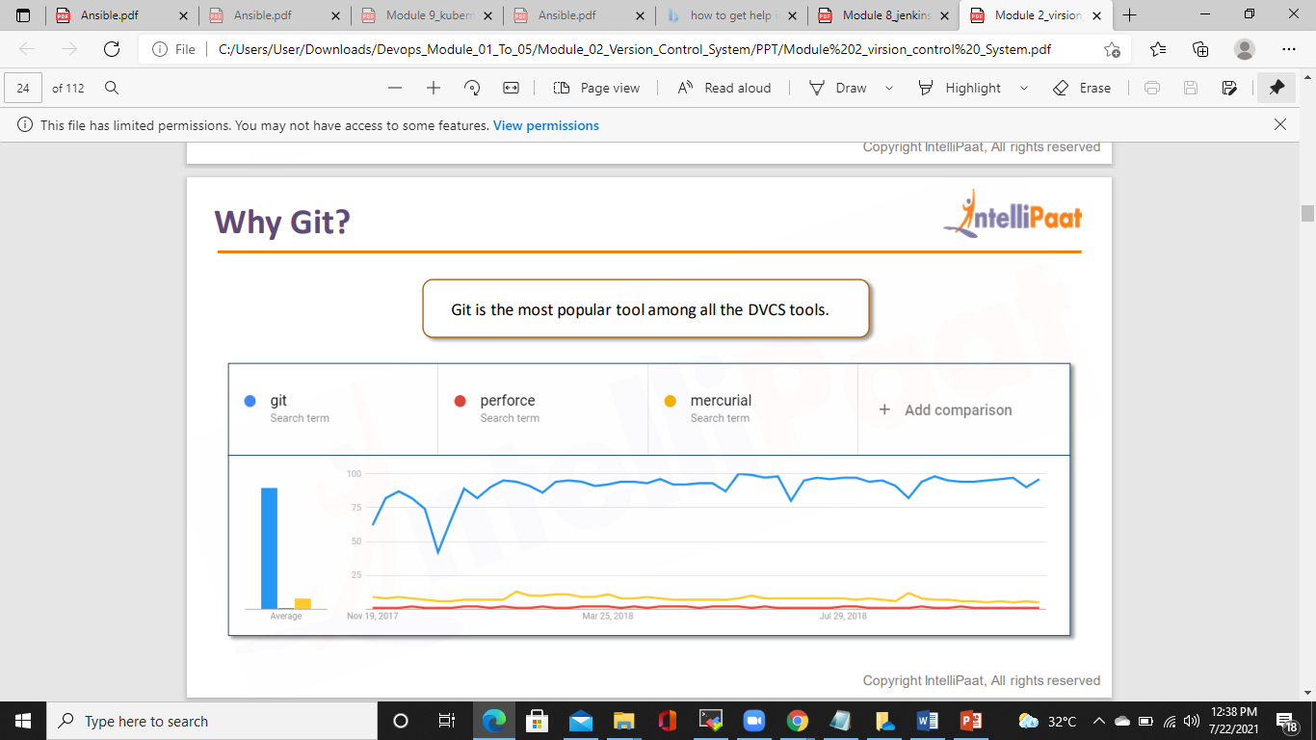
WHY GIT

Slide 25
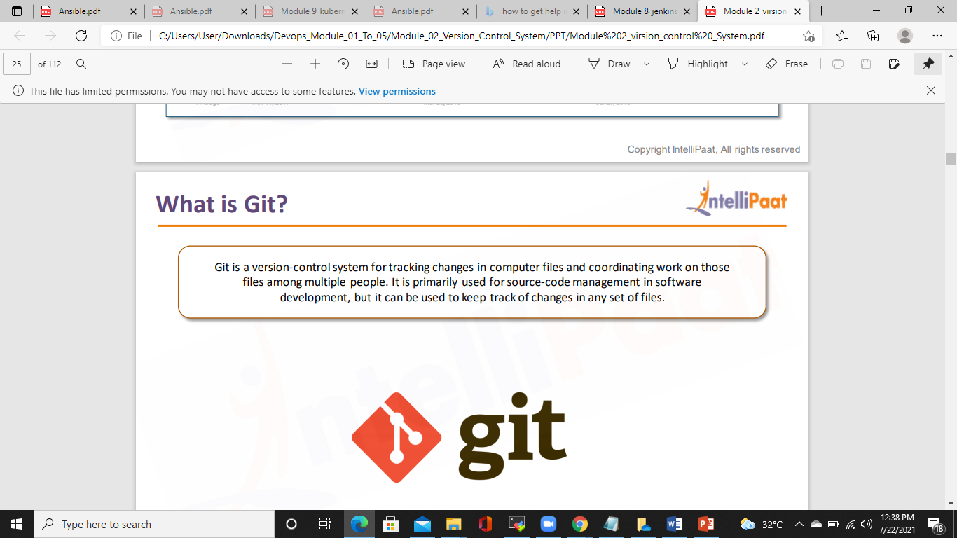
WHAT IS GIT

Slide 26
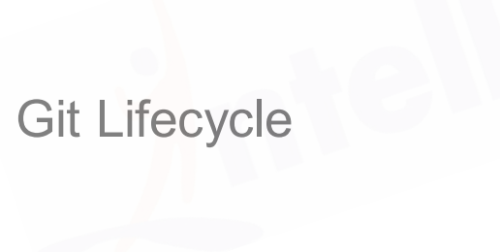

Slide 27
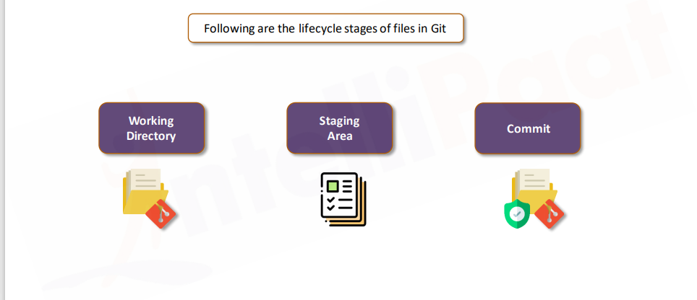
GIT LIFECYCLE

Slide 28
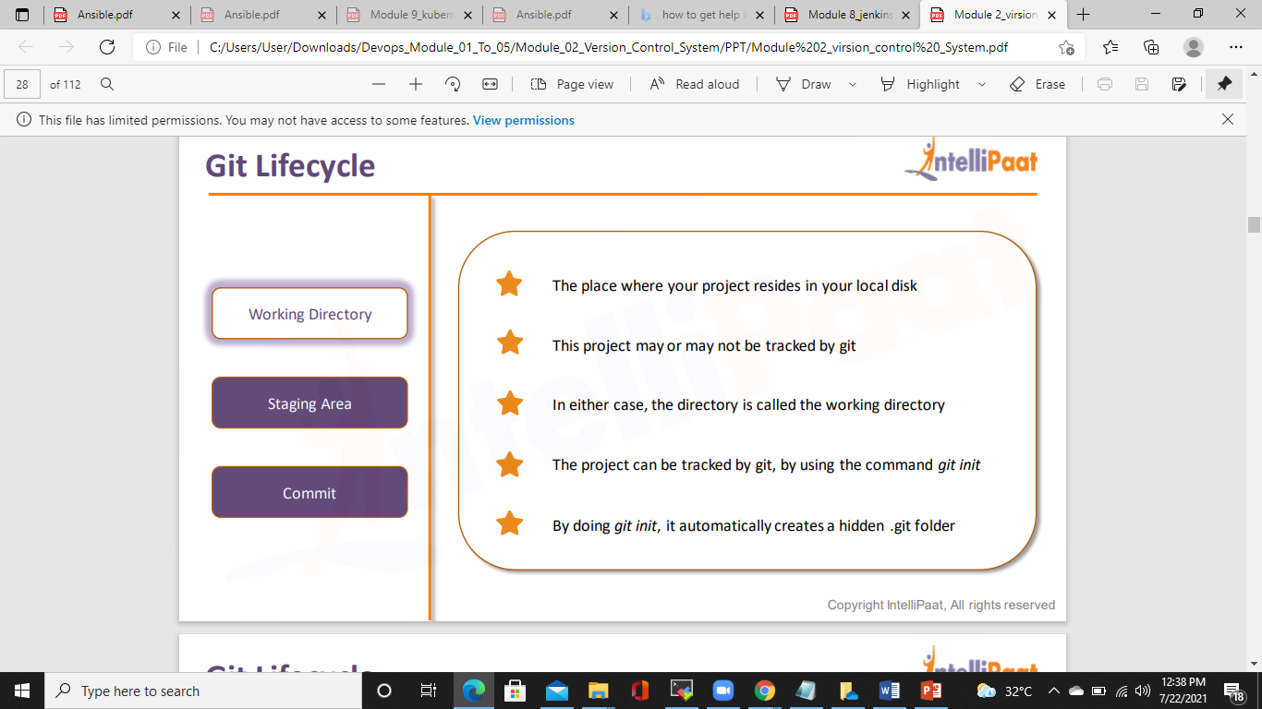
GIT LIFECYCLE

Slide 29
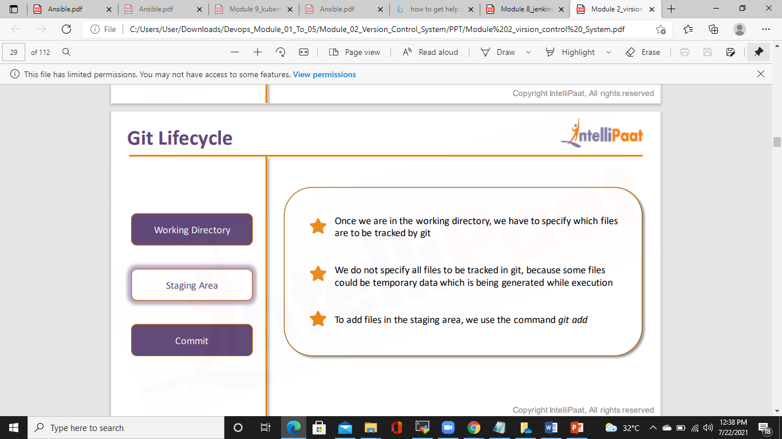
GIT LIFECYCLE

Slide 30
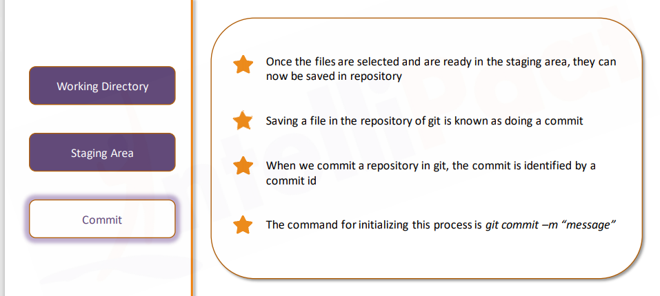
GIT LIFECYCLE

Slide 31
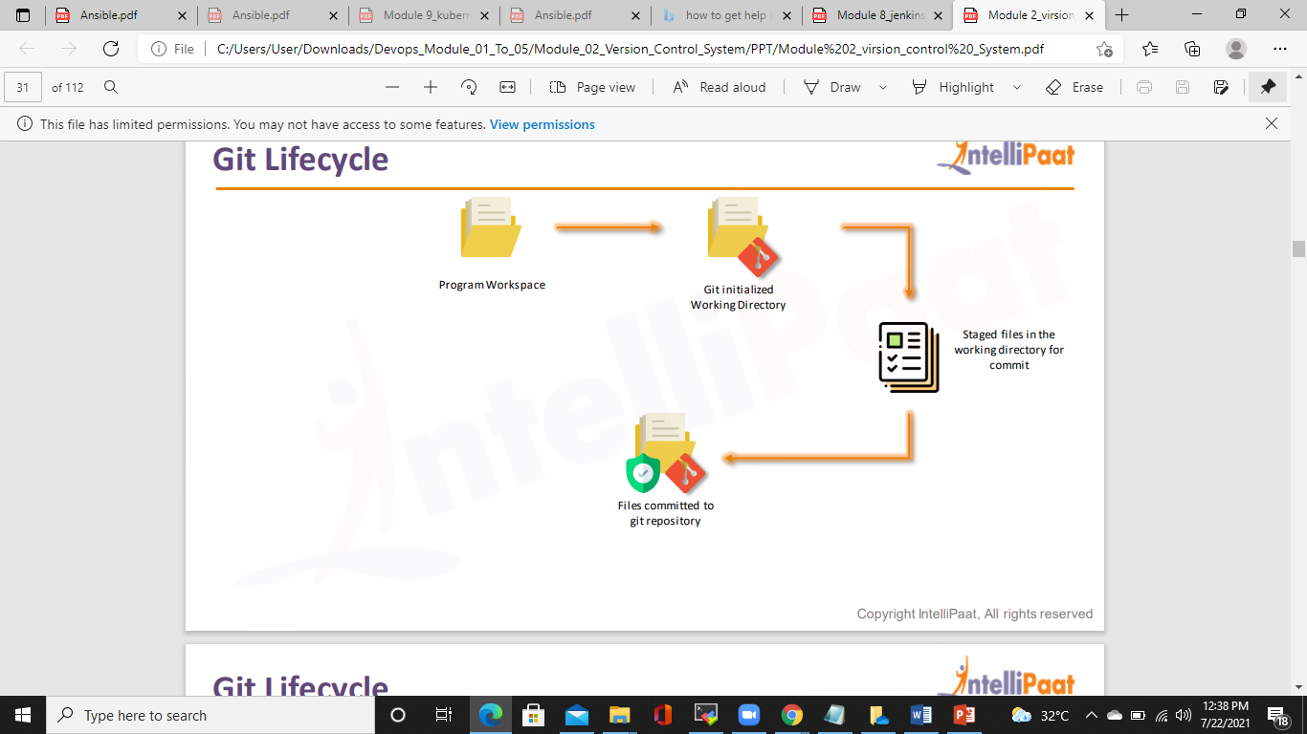
GIT LIFECYCLE

Slide 32
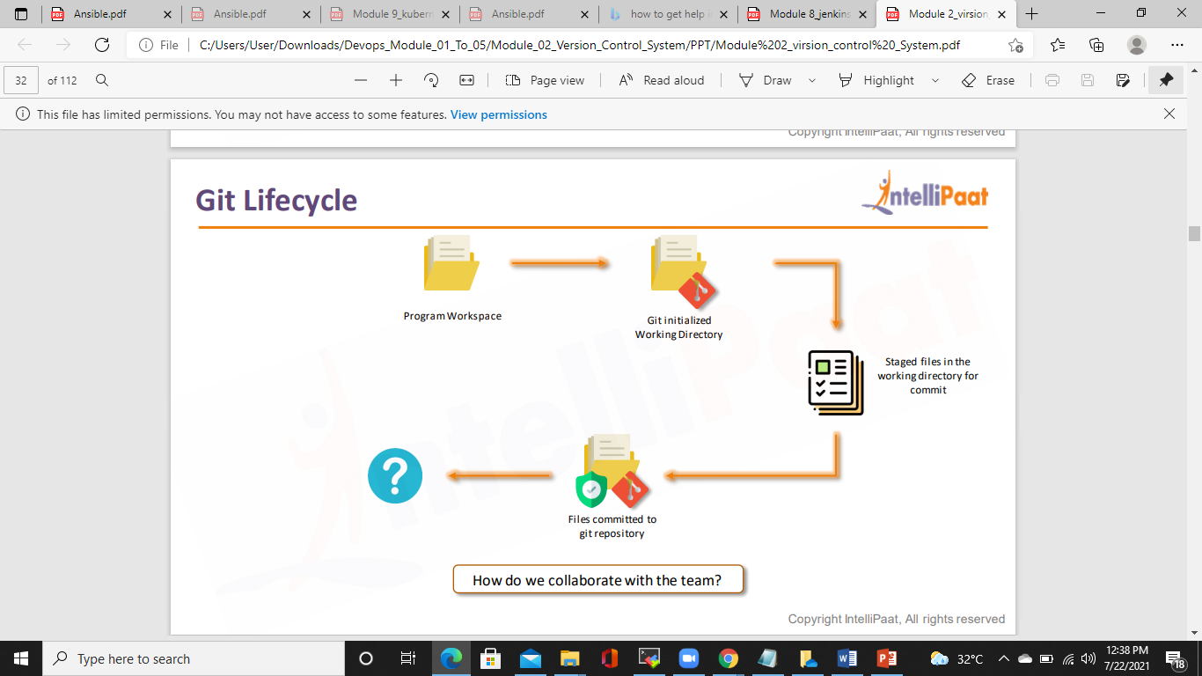
GIT LIFECYCLE

Slide 33
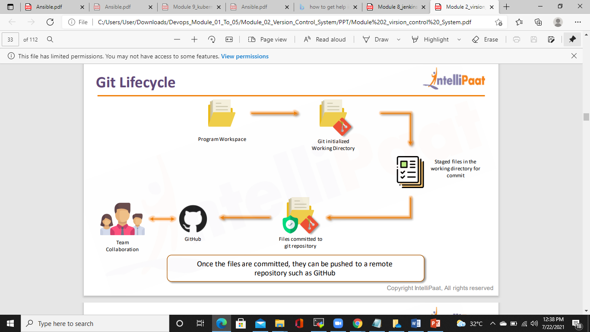
GIT LIFECYCLE

Slide 34
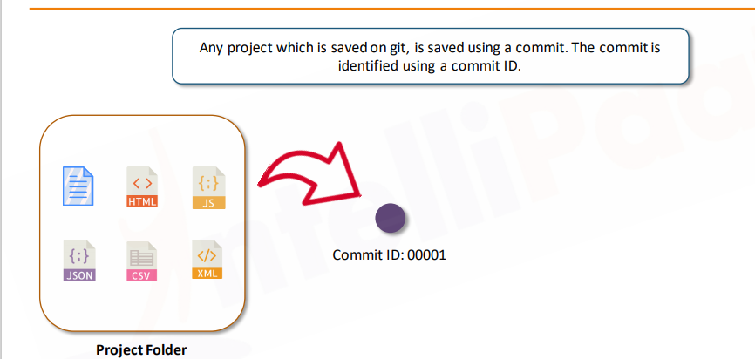
How does Git Work?

Slide 35
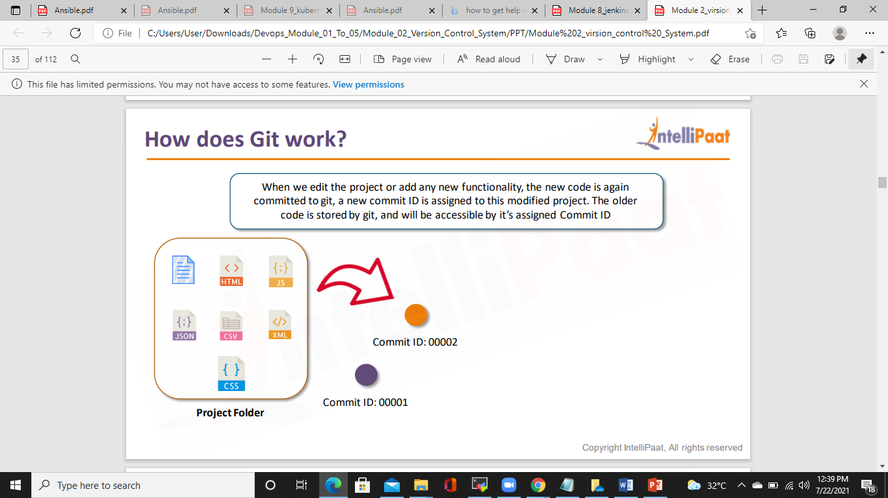
How does Git Work?

Slide 36
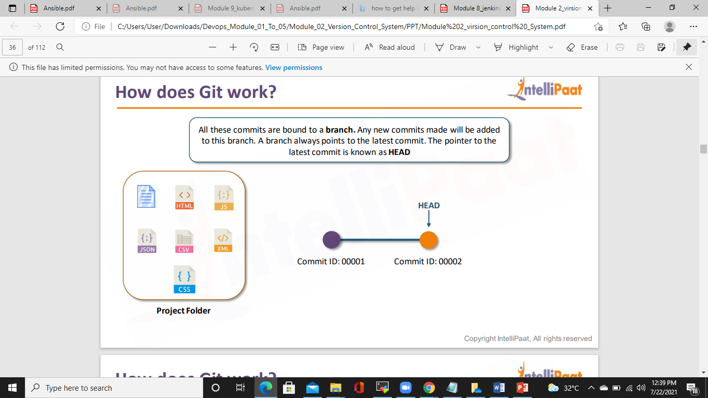
How does Git Work?

Slide 37
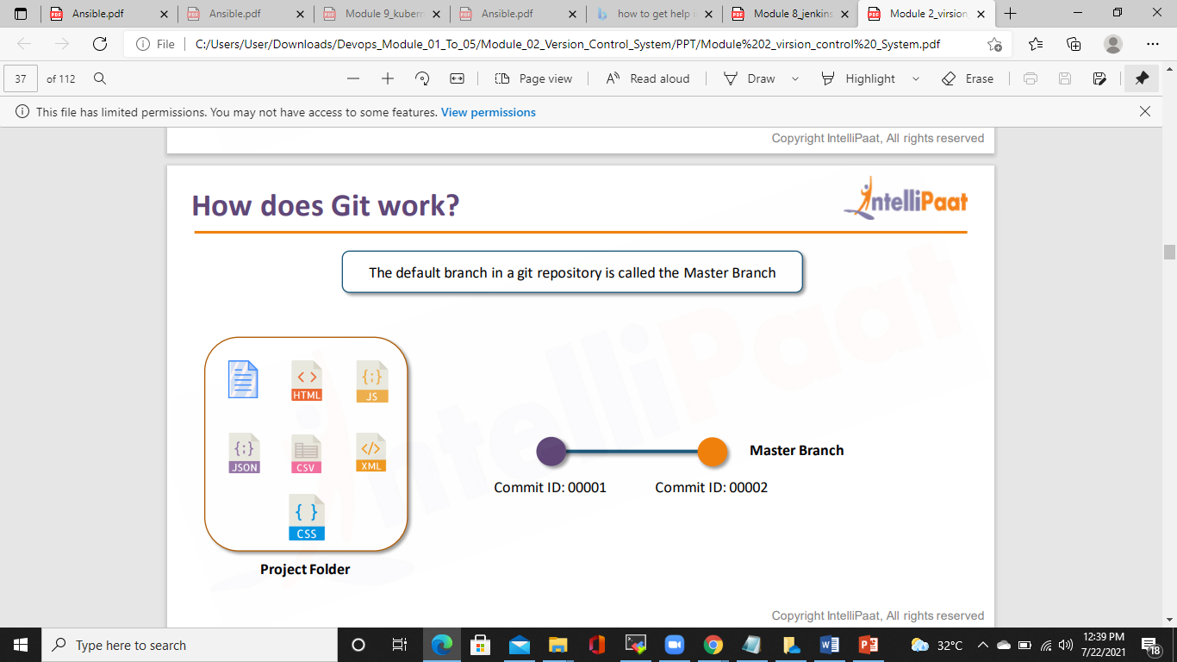
How does Git Work?

Slide 38
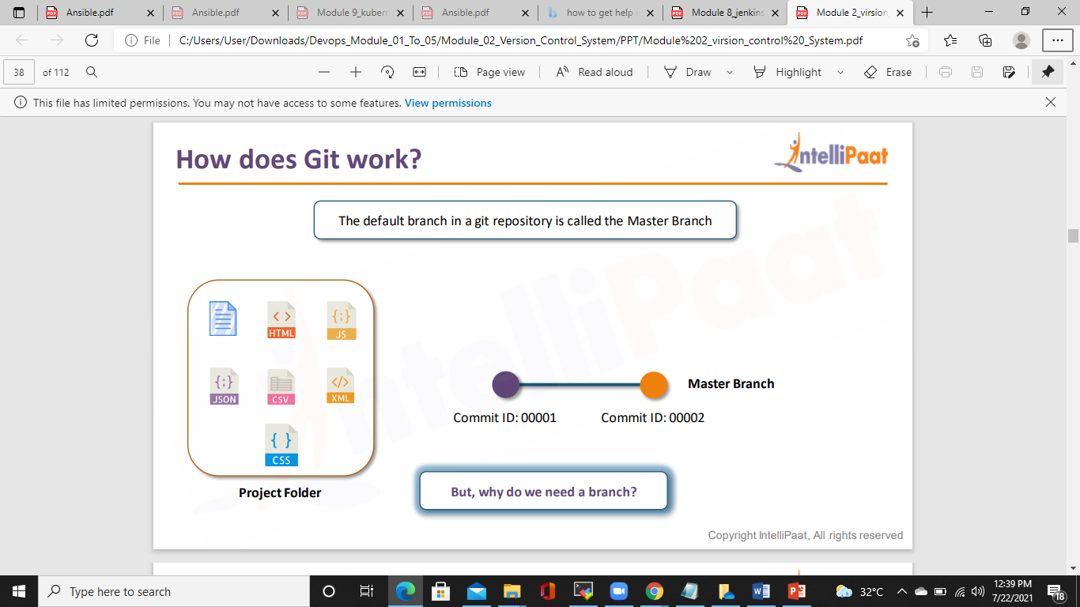
How does Git Work?

Slide 39
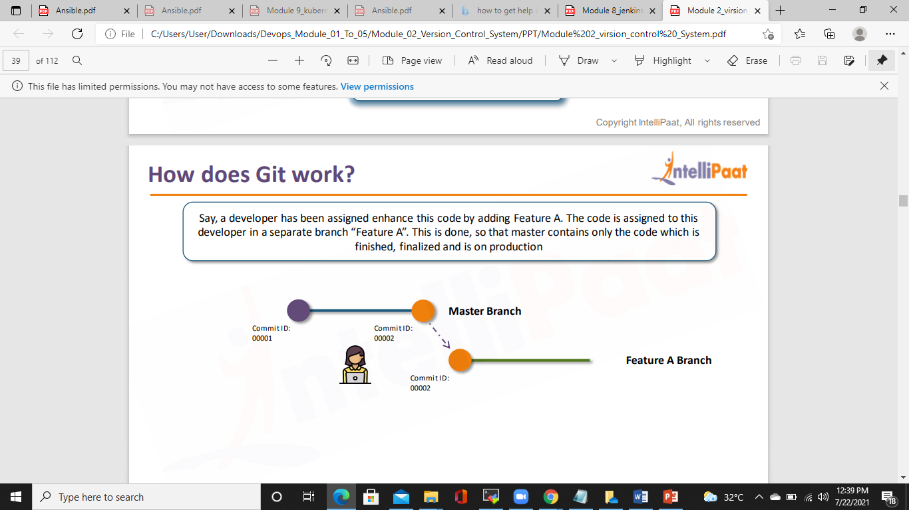
How does Git Work?

Slide 40
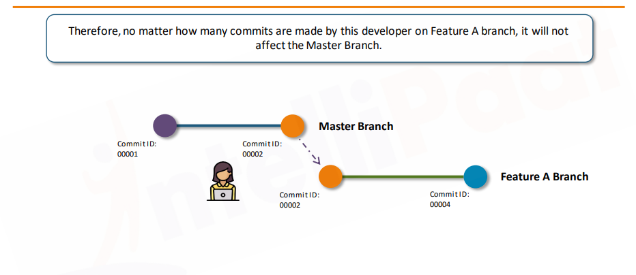
How does Git Work?

Slide 41
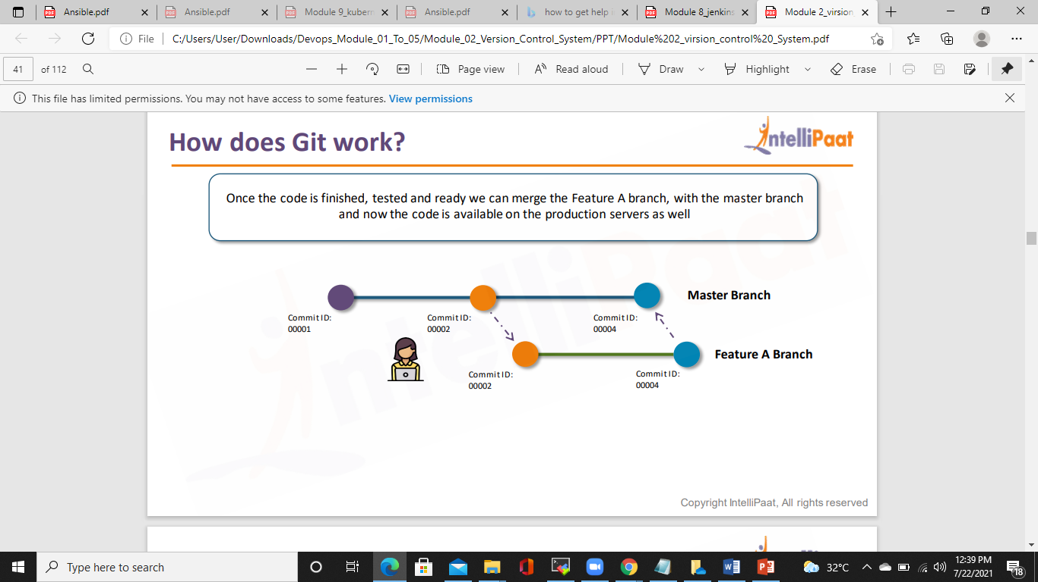
How does Git Work?

Slide 42
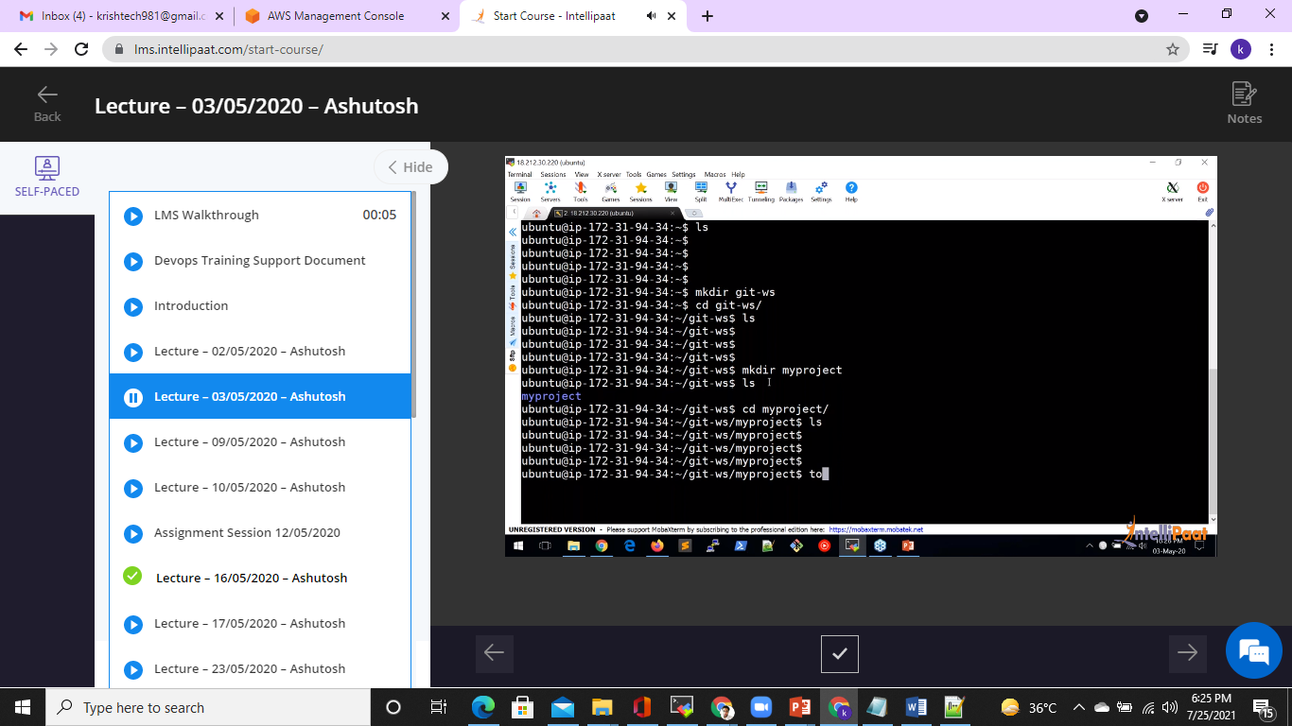

Slide 43


Slide 44
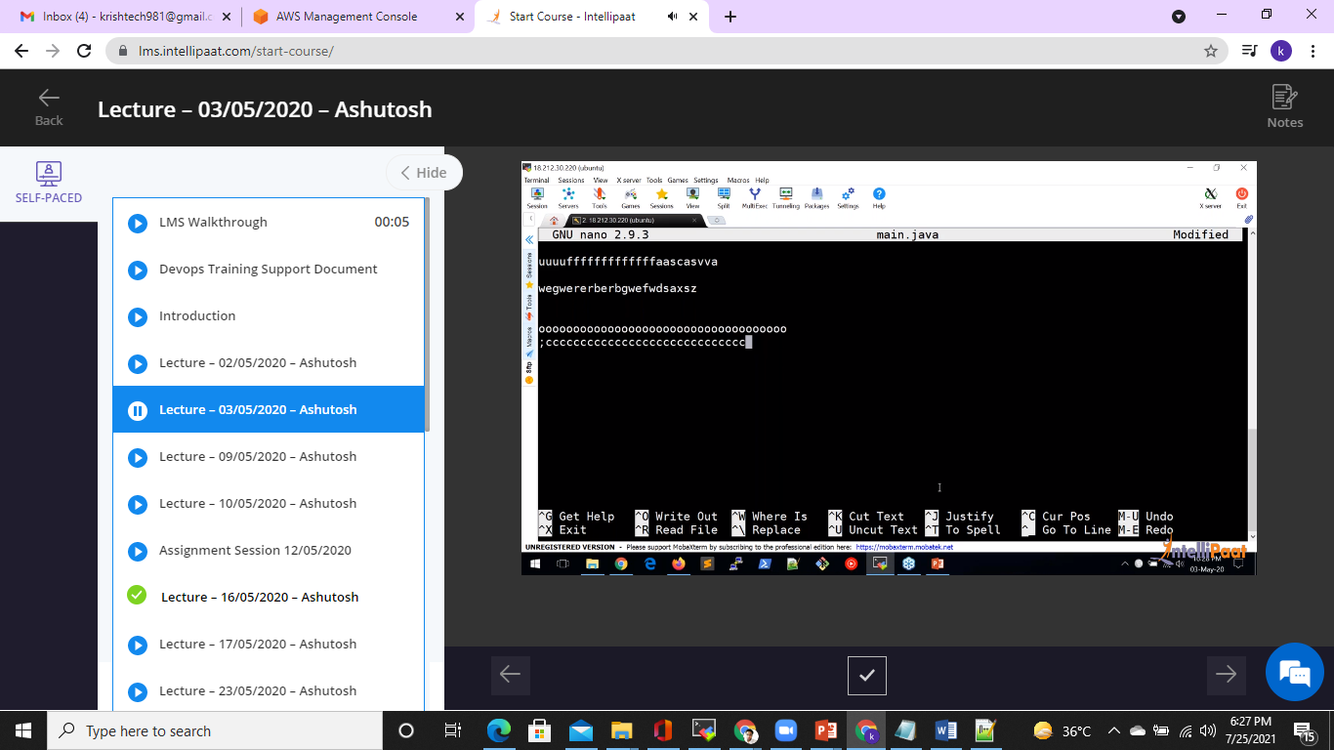

Slide 45
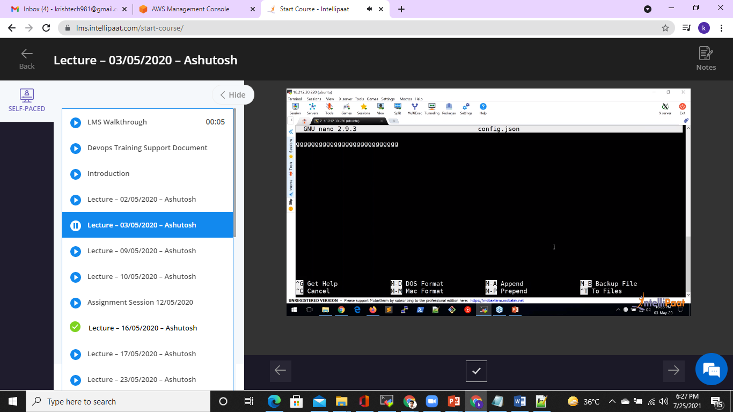

Slide 46


Slide 47
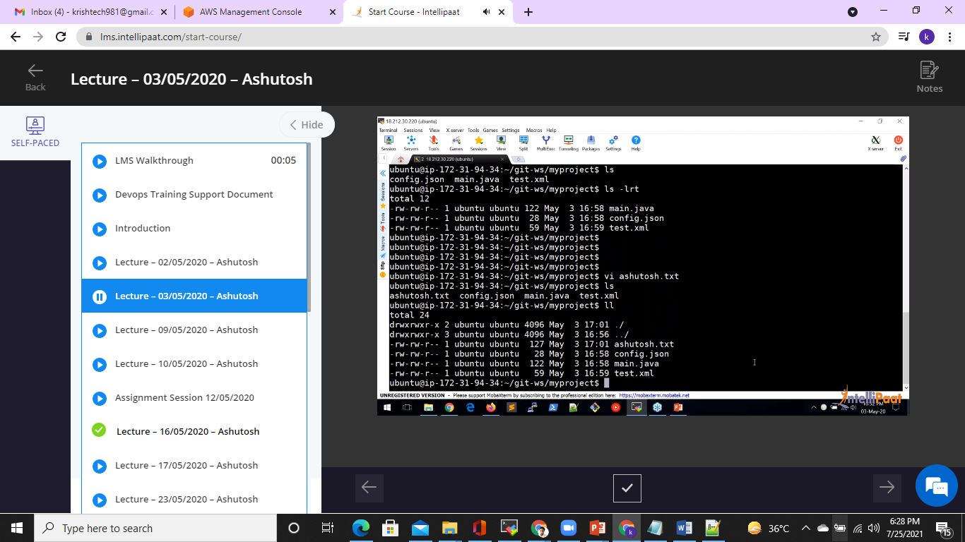

Slide 48
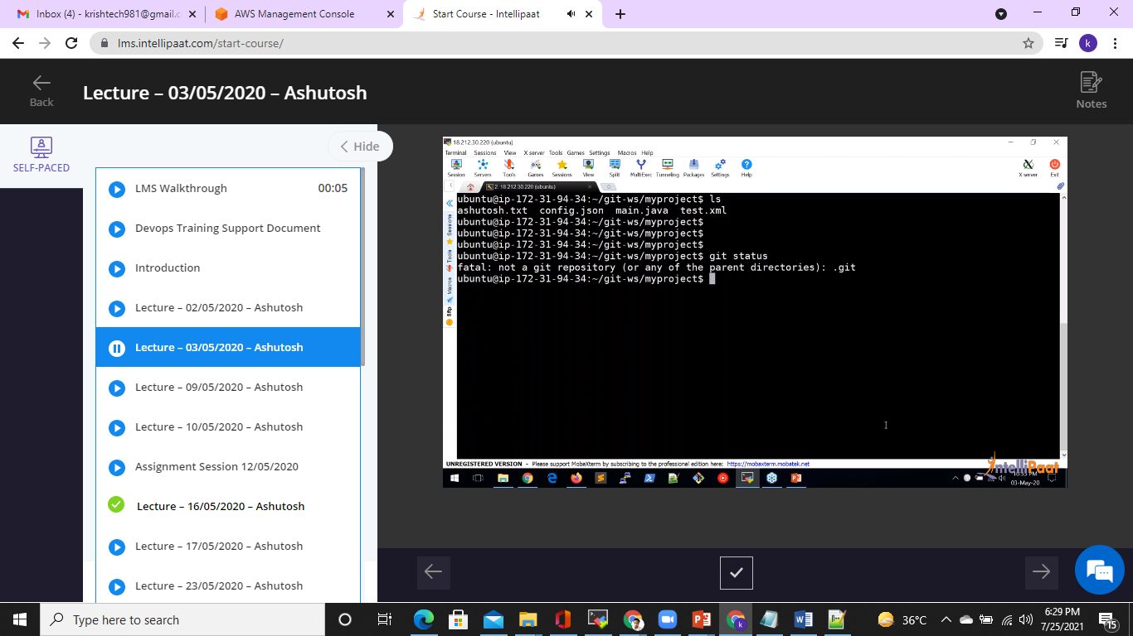

Slide 49
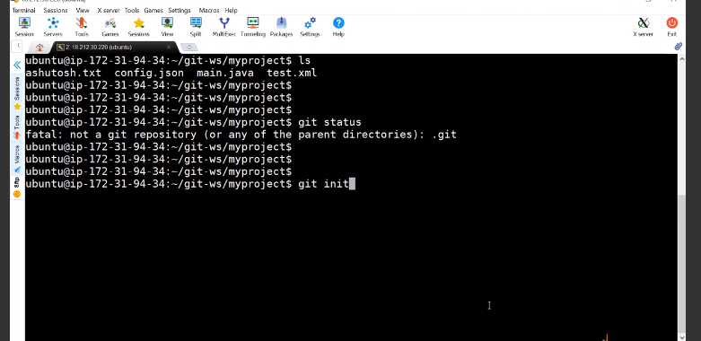

Slide 50
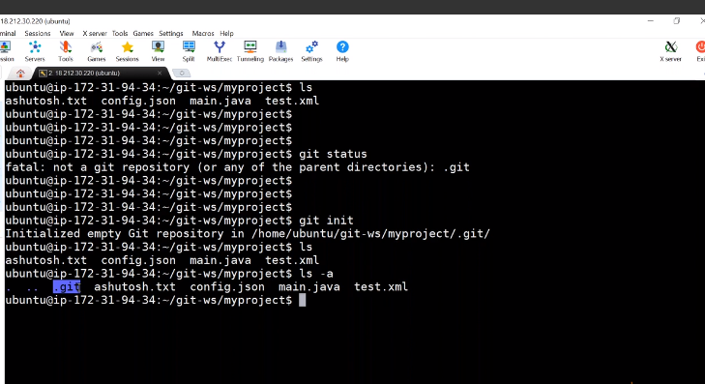

Slide 51
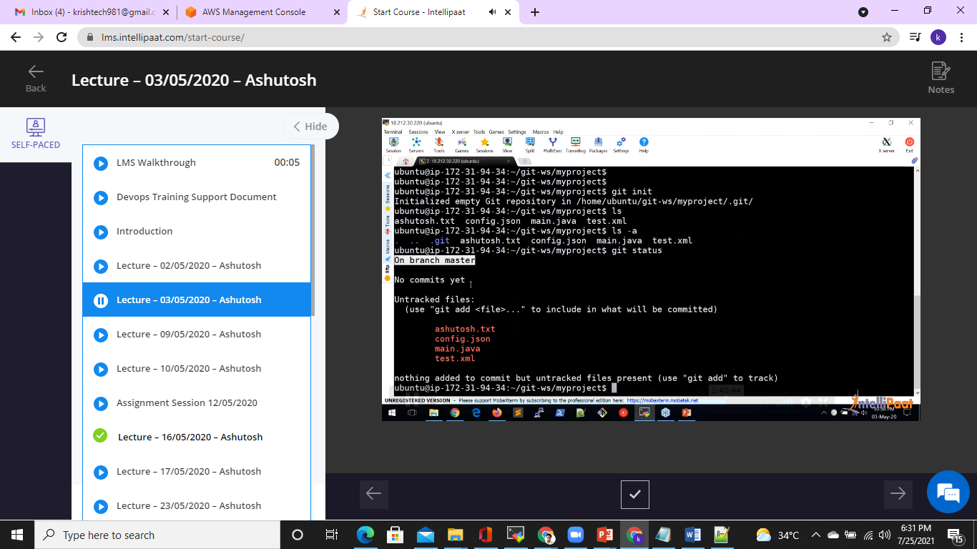

Slide 52


Slide 53
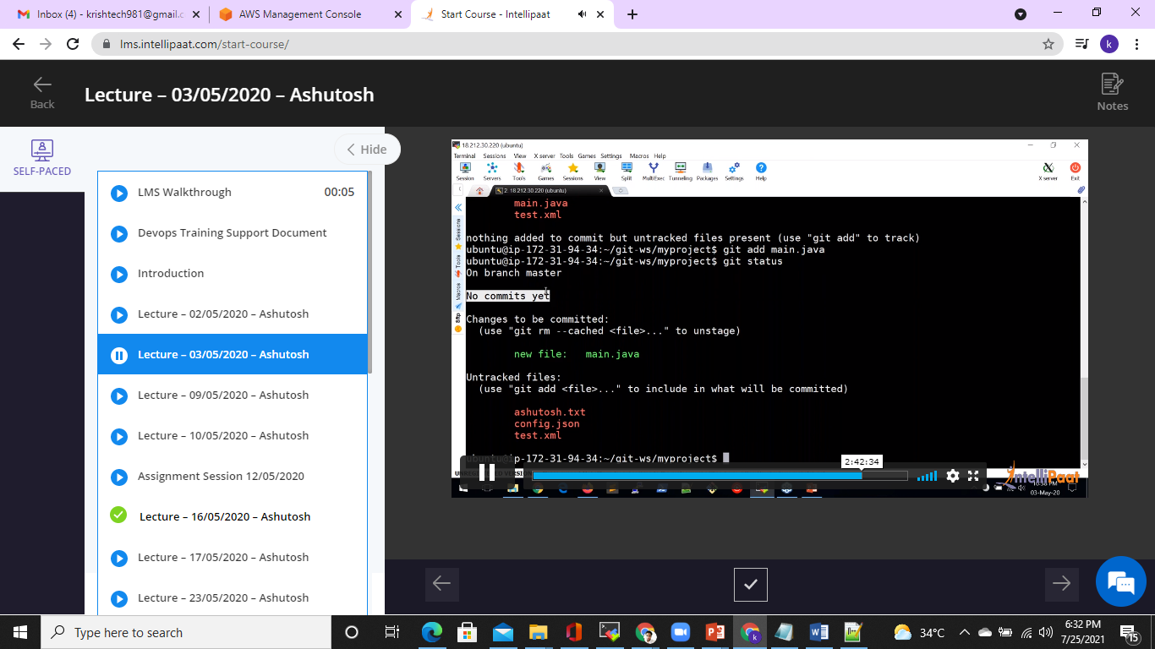

Slide 54


Slide 55


Slide 56


Slide 57


Slide 58


Slide 59


Slide 60


Slide 61


Slide 62


Slide 63


Slide 64


Slide 65

Common GIT Commands

Slide 66

Common GIT Commands

Slide 67

Common GIT Commands

Slide 68

Common GIT Commands

Slide 69

Common GIT Commands

Slide 70

Common GIT Commands

Slide 71

Common GIT Commands

Slide 72

Common GIT Commands

Slide 73

Common GIT Commands

Slide 74


Slide 75

Merging Branches

Slide 76

Merging Branches

Slide 77

Merging Branches

Slide 78

Merging Branches

Slide 79

Merging Branches

Slide 80


Slide 81


Slide 82


Slide 83


Slide 84


Slide 85


Slide 86


Slide 87


Slide 88


Slide 89


Slide 90


Slide 91


Slide 92


Slide 93


Slide 94


